Slide 1

CodeStock is proudly partnered with:
RecruitWise and Staff with Excellence - www.recruitwise.jobs
Send instant feedback on this session via Twitter:
Send a direct message with the room number to @CodeStock
d codestock 503 This session is great!
For more information on sending feedback using Twitter while at CodeStock, please see the “CodeStock README” in your CodeStock guide.

Slide 2

Wrox Press
Join the discussion
Facebook: www.facebook.com/wroxpress
Twitter: @wrox

Slide 3

Tim Costello
Dimensional Design 101

Slide 4
Tim Costello
MCIPT SQL 2005 Administration
MCTS SQL 2008 Business Intelligence
Tableau Certified Professional
Dallas Tableau User Group leader.
Business Intelligence Consultant
  for Interworks Inc.
  www.Interworks.com

Slide 5
Inman Corporate Information Factory (CIF)
- vs -
Kimball Data Warehouse (DW)

Slide 6
Inman Corporate Information Factory (CIF)
- vs -
þ
Kimball Data Warehouse (DW)

Slide 7
Things we will cover …
þ
Dimensional Bus

Slide 8
Things we will cover …
þ
Dimensional Bus
þ
Fact Tables

Slide 9
Things we will cover …
þ
Dimensional Bus
þ
Fact Tables
þ
Dimension Tables

Slide 10
Things we will not cover …
ý
Mega Data Warehouse

Slide 11
Things we will not cover …
ý
Mega Data Warehouse
ý
OLAP

Slide 12
Things we will not cover …
ý
Mega Data Warehouse
ý
OLAP
ý
ETL (Extract Transform Load)

Slide 13
Things we will not cover …
ý
Mega Data Warehouse
ý
OLAP
ý
ETL (Extract Transform Load)
ý
Presentation Layer

Slide 14
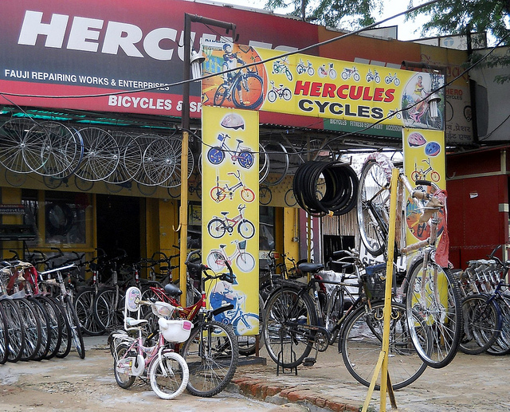
http://www.flickr.com/photos/comprock/4937334032/sizes/z/in/photostream/

Slide 15
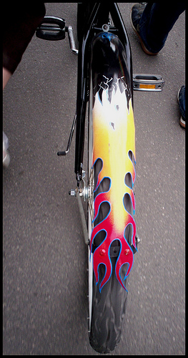


http://www.flickr.com/photos/scottmontreal/2475391816/sizes/m/in/photostream/
http://www.flickr.com/photos/cpoyatos/4374856699/sizes/m/in/photostream/
http://www.tcpalm.com/photos/2009/aug/05/193893/

Slide 16
Transactional Database

Slide 17
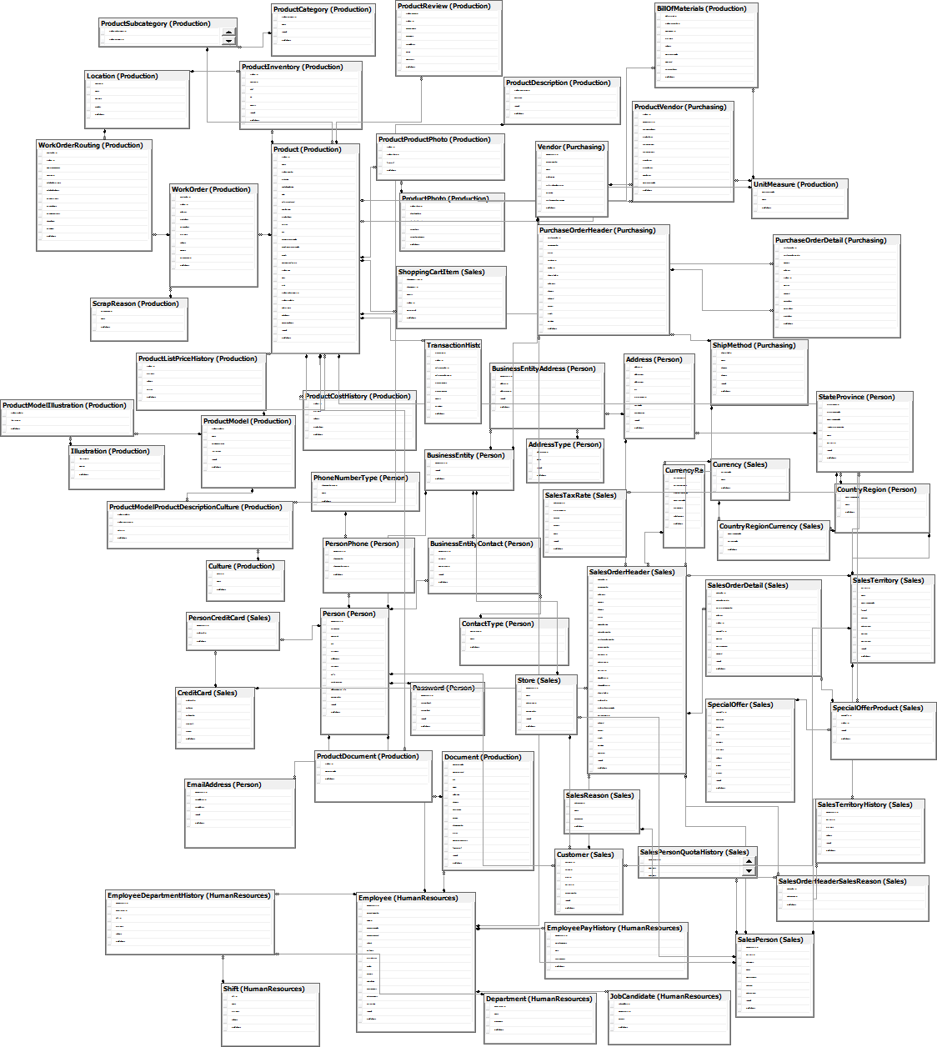

Slide 18
Dimensional Design

Slide 19
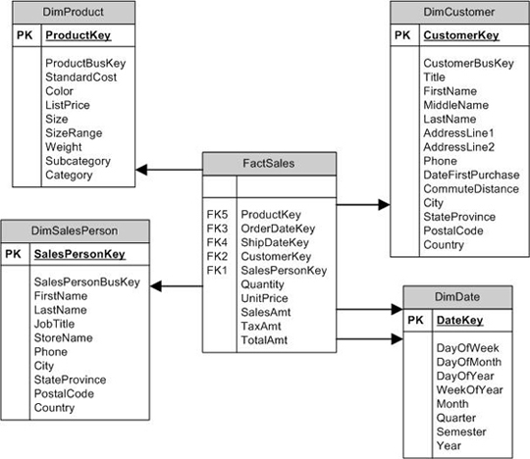
Star Schema

Slide 20
Snowflake Schema

Slide 21
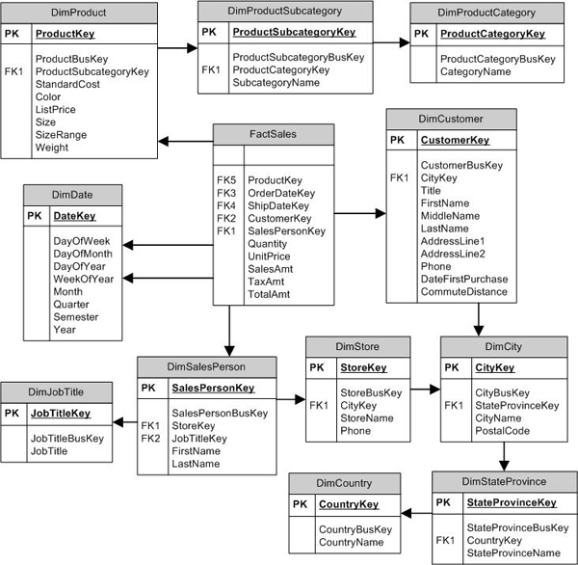

Slide 22
Dimensional Bus

Slide 23
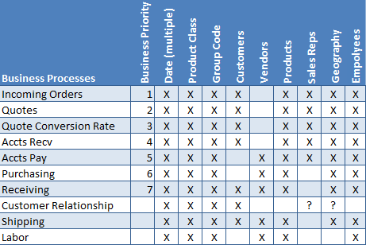

Slide 24
Fact Table

Slide 25
Fact Tables Contain
Foreign Keys
Measures
Degenerate Dimensions
*
* Sometimes.

Slide 26
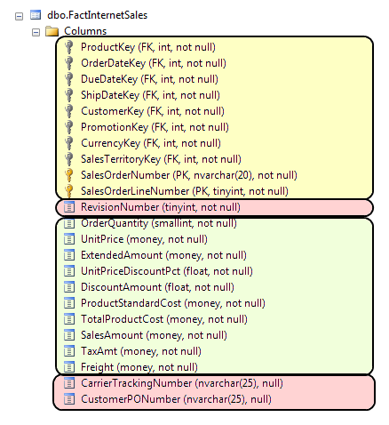

Slide 27
3 Kinds Of Fact Table
þ
Transactional Fact Table

Slide 28
3 Kinds Of Fact Table
þ
Transactional Fact Table
þ
Accumulating Snapshot

Slide 29
3 Kinds Of Fact Table
þ
Transactional Fact Table
þ
Accumulating Snapshot
þ
Periodic Snapshot

Slide 30
Transactional Fact Table

Slide 31
Accumulating Snapshot

Slide 32
Periodic Snapshot

Slide 33
Dimension Tables

Slide 34
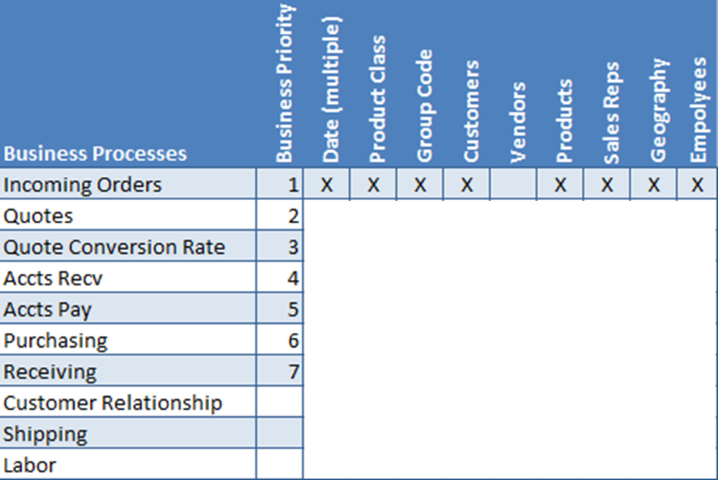

Slide 35
SELECT
DateId
, FullDate
, NextDayDate
, Season
, CalendarYear
, CalendarYearQuarter
, CalendarYearMonth
, CalendarYearDayOfYear
, CalendarQuarter
, CalendarMonth
, CalendarDayOfYear
, CalendarDayOfMonth
…

Slide 36
, CalendarDayOfWeek
, CalendarYearName
, CalendarYearQuarterName
, CalendarYearMonthName
, CalendarYearMonthNameLong
, CalendarQuarterName
, CalendarMonthName
, CalendarMonthNameLong
, WeekdayName
, WeekdayNameLong
, CalendarStartOfYearDate
, CalendarEndOfYearDate
, CalendarStartOfQuarterDate
…

Slide 37
, CalendarEndOfQuarterDate
, CalendarStartOfMonthDate
, CalendarEndOfMonthDate
, QuarterSeqNo
, MonthSeqNo
, FiscalYearName
, FiscalYearPeriod
, FiscalYearDayOfYear
, FiscalYearWeekName
, FiscalSemester
, FiscalQuarter
, FiscalPeriod
, FiscalDayOfYear
…

Slide 38
, FiscalDayOfPeriod
, FiscalWeekName
, FiscalStartOfYearDate
, FiscalEndOfYearDate
, FiscalStartOfPeriodDate
, FiscalEndOfPeriodDate
, ISODate
, ISOYearWeekNo
, ISOWeekNo
, ISODayOfWeek
, ISOYearWeekName
, ISOYearWeekDayOfWeekName
, DateFormatYYYYMMDD
…

Slide 39
, DateFormatYYYYMD
, DateFormatMMDDYEAR
, DateFormatMDYEAR
, DateFormatMMMDYYYY
, DateFormatMMMMMMMMMDYYYY
, DateFormatMMDDYY
, DateFormatMDYY
, WorkDay
, IsWorkDay
from dbo.Dim_Date

Slide 40
Conformed Dimensions

Slide 41
Role Playing Dimensions
factEmployeeReview
dimDate
EmployeeID
StartDateKey
EndDateKey
…
DateKey
Full_Date
NextDayDate
Season
…
20110102
20110103

Slide 42
dimStartDate (View based on dimDate)
StartDateKey
Full_Date
NextDayDate
Season
…
factEmployeeReview
EmployeeID
StartDateKey
EndDateKey
…
dimEndDate (View based on dimDate)
EndDateKey
Full_Date
NextDayDate
Season
…

Slide 44
Resources and Links

Slide 45
Kimball Design Tip #18: Taking The Publishing Metaphor Seriously: http://www.rkimball.com/html/designtipsPDF/DesignTips2001/KimballDT18Taking.pdf
Kimball Design Tip #46: Another Look At Degenerate Dimension: http://www.rkimball.com/html/designtipsPDF/DesignTips2003/KimballDT46AnotherLook.pdf
Design Tip #113 Creating, Using, and Maintaining Junk Dimension: http://www.rkimball.com/html/09dt/DT113CreatingUsingMaintainingJunkDimensions.pdf
Design Tip #105 Snowflakes, Outriggers, and Bridges: http://www.rkimball.com/html/08dt/KU105Snowflakes_Outriggers_Bridges.pdf
Kimball Design Tip #51: Latest Thinking On Time Dimension Table: http://www.kimballuniversity.com/html/designtipsPDF/KimballDT51LatestThinking.pdf
Design Tip #69 Identifying Business Processes: http://www.rkimball.com/html/designtipsPDF/DesignTips2005/DTKU69IdentifyingBusinessProcesses.pdf
Kimball Design Tip #37: Modeling A Pipeline With An Accumulating Snapshot: http://www.rkimball.com/html/designtipsPDF/DesignTips2002/KimballDT37ModelingPipeline.pdf
Kimball Design Tip #16: Hot Swappable Dimension: http://www.rkimball.com/html/designtipsPDF/DesignTips2000%20/KimballDT16HotSwappable.pdf
Kimball Design Tip #21: Declaring The Grain: http://www.rkimball.com/html/designtipsPDF/DesignTips2001/KimballDT21Declaring.pdf
Fundamental Grains: http://www.kimballgroup.com/html/articles_search/articles1999/9903IE.html?TrkID=IE199903_2

Slide 46

Twitter:
@TimCost
www.TheDataRevolution.com
Email:
Tim.Costello@Interworks.com

